Slide 1
Teaching F# and Functional Programming
Tomáš Petříček
PhD Student, University of Cambridge tomas.petricek@cl.cam.ac.uk | http://tomasp.net/blog

Slide 2
Teaching F#
Professional Software Developers
Real-World Functional Programming book
Tutorial at QCon 2011
University Students
Course at Charles University, Prague
Online talk at Community for F#

Slide 3
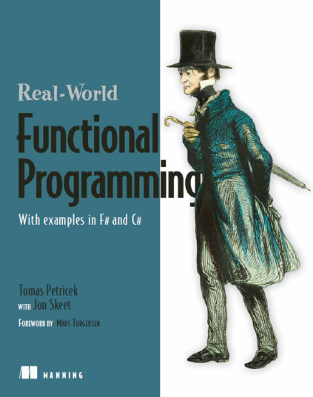
Real-World Functional Programming
First Part
Introduce idea in C# and then show the F# equivalent (e.g. list type)
Second Part
Relate C# and F# concepts (e.g. class hierarchy and discriminated unions)
Third Part
Use functional ideas in practice
F# examples (with C# version where applicable)

Slide 4
Representing event schedule
Object-oriented way
Easy to add new cases
Hard to add new functions
Functional way
Easy to add new functions
Hard to add new cases
Mixed functional/OO languages give you both options!

Slide 5
Demo
Functional Data Structures in C#

Slide 6
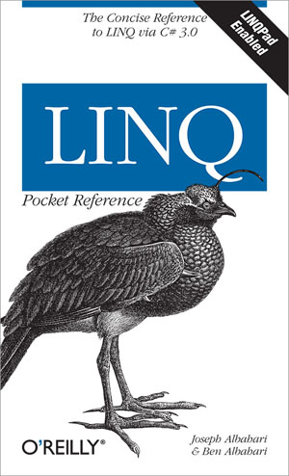
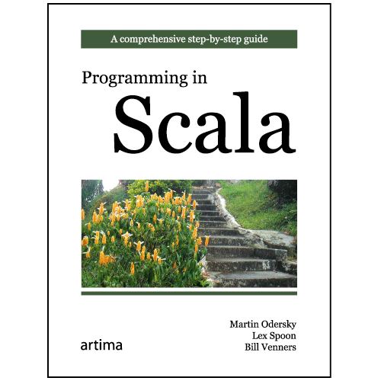

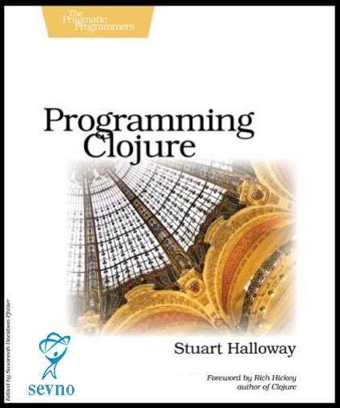
FP hits mainstream
Visual Studio gets F#
C# gets LINQ, lambdas, etc
C++ gets lambdas
JVM gets Clojure & Scala

Slide 7
Writing queries with LINQ
Query syntax supported in C# 3.0
Functional programming concepts
Declaratively describes “what” not “how”
Written as single expression
var q =
from p in db.Products
where p.UnitPrice > 75.0M
select String.Format("{0} - ${1}",
p.ProductName, p.UnitPrice);

Slide 8
Graphical User Interface Frameworks
XUL (Mozilla), Glade (Gtk), XAML (.NET)
Functional programming concepts
Compose button with ellipse inside
Specify behavior declaratively
<Button x:Name="greenBtn" Background="Black">
<Ellipse Width="75" Height="75" Fill="LightGreen" />
</Button>
<DoubleAnimation Storyboard.TargetName="greenBtn"
Storyboard.TargetProperty="(Canvas.Left)"
From="0.0" To="100.0" Duration="0:0:5" />

Slide 9
Specifying financial contracts in F#
Functional programming concepts
Declaratively describes “what” not “how”
Written as single expression
Composed from small number of primitives
let march day = DateTime(2011, 3, day)
let itTrades =
(sell (tradeAt (march 15) "GOOG" 500)) $
(between (march 10) (march 19) (trade "MSFT" 1000))
let tradeAt date what amount =
between date date (trade what amount)

Slide 10

Point of sale sample
Easy to understand sample
Problem domain
Describe using functional types
Transformations between representations
Easy to understand and test
Reactive user interface
Implemented using asynchronous workflows

Slide 11
Demo
Line of Sale application

Slide 12
Teaching F#
Professional Software Developers
Real-World Functional Programming book
Tutorial at QCon 2011
University Students
Course at Charles University, Prague
Online talk at Community for F#

Slide 13
F# as a first (functional) language?
Mathematically oriented language
Supplements math and theory courses
Eliminates differences between students
Open-source with cross-platform support
F# for MonoDevelop on Linux/Mac
Practical language with some market
.NET/Mono skills are valued by industry
Very easy transition to C# and other languages

Slide 14
Scaling math
Functional programming is like math
Composition doesn’t break things
Things do not change
Math expression as the basic block
Evaluating expressions in F# Interactive
Expressions scale beyond numbers
Composing graphical objects
Composing financial contracts

Slide 15
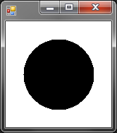
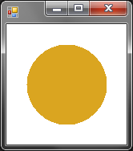
Composing graphics
Expressions that have drawing as the result
Same concepts as mathematical expressions
Basic shapes
Functions for creating new shapes
> Fun.circle 100.0f;;
val it : Drawing = (Drawing 100x100)
> Fun.fillColor Color.Goldenrod
(Fun.circle 100.0f);;
val it : Drawing = (Drawing 100x100)

Slide 16
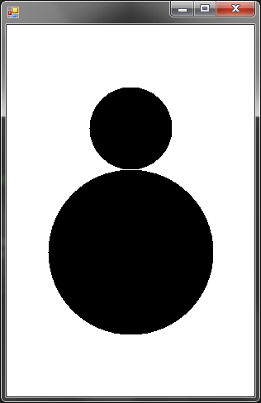



Working with shapes
Composing drawings ($)
Let declarations to reuse drawings
Fun.circle 200.0f $
Fun.move 0.0f 150.0f (Fun.circle 100.0f)
let plus =
Fun.lineStyle 2.0f Color.SteelBlue
( Fun.line -10.0f 0.0f 10.0f 0.0f $
Fun.line 0.0f -10.0f 0.0f 10.0f )
let star = plus $ (Fun.rotate 45.0f plus)
let bigStar = Fun.scale 2.0f 2.0f star

Slide 17
Demo
Composing 3D graphics

